Slide 1
ELEN7046: Big Data Visualization Using Commodity Hardware and Open Source Software
Presenter: Group 2
Date: 22 June 2016
Group 2:
Sidwell Mokhemisa 1229756 Dave Cloete 1573016
Kyle Trehaeven 0602877N Gareth Stephenson 778919
Matsobane Khwinana 779053

Slide 2
Sidwell Mokhemisa

Slide 3
Agenda
Context
Project Organization
Lifecycle Method: IBM RUP
Architecture
Detailed Design
Summary of Used Technologies
Conclusion
Demo and Q & A

Slide 4
Context
Big Data Acquisition
Processing
Technologies
Visualization
Acquisition of Elections related data from Twitter (US and RSA).
Raspberry Pi 3 Cluster.
Map-Reduce applied to process large sets of data.
D3 Charts used for visualization of Big Data.
Web presentation using Node.js
Past and Present feeds
All of the above running mainly on Commodity Hardware

Slide 5
Project Organization
Sidwell Mokhemisa
Kyle Trehaeven
Development for data Acquisition (Streaming)
Gareth Stephenson
Matsobane Khwinana
Dave Cloete
Development Method
Architecture (High Level Designs)
Development for data Acquisition (History)
Involvement in the Visualization Development
Involvement in the Scala Development
Infrastructure Setup (Pi Cluster)
MapReduce Development using Scala
UX Design
Development for visualization

Slide 6
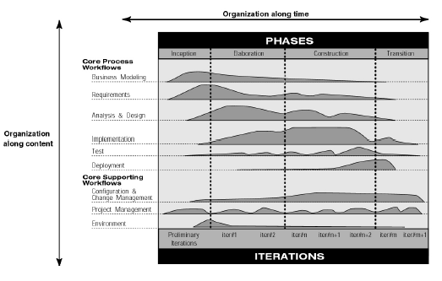
Lifecycle Method: IBM RUP

Slide 7
Lifecycle Method: IBM RUP (Tailoring Process)
Core-Process Workflows | Elaboration Phase | Tailoring
Business Model
Requirements | A Use-Case Model | T
 | Supplementary Requirements Capturing (NFR) | T
Analysis and Design | A Software Architecture Description | I
Implementation | An Executable Architectural Prototype | T
Test
Deployment
Core Supporting Workflows | Elaboration Phase | Tailoring
Config & Change Management | A Preliminary User Manual (Optional) | N/A
Project Management | A Revised Risk List and business case | T
 | A development plan for overall project | T
 | An Updated development case specifying process to follow | T
Environment
T = Tailored
N/A = Not Delivered
I = Included

Slide 8
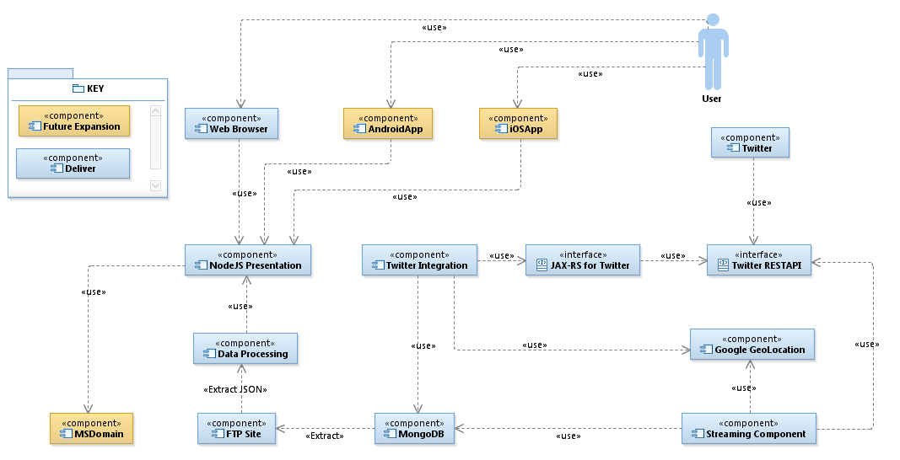
Architecture: High Level Component Model
User shall connect to the data visualization front-end using a Web browser. This was built using D3 Chartz.
Data Processing shall be done using MapReduce principles using JSON files directly stored on file system.
The data source used for the project is social media based and comes from Twitter (History and Streaming)
Integration to Twitter was established using Java (History Data) and C# (Streaming Data) with Google Maps used to validate “tweet” location where possible.
1
3
4
2

Slide 9
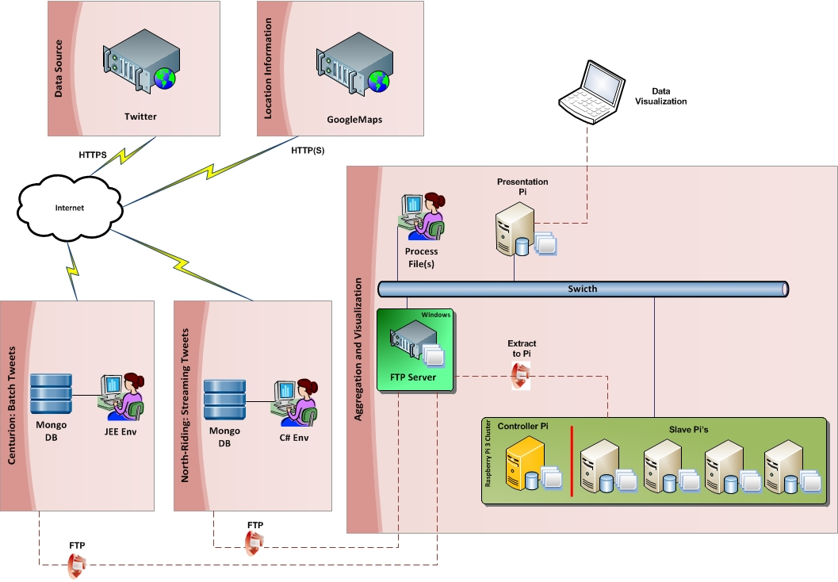
Architecture: Infrastructure Design

Slide 10
Matsobane Khwinana

Slide 11
Role, Tools and Technologies
Data sourcing – history data
A bit of data visualisation
Tools and Technologies used:
Java SE 8, Java EE 7, Jboss WildFly 10
Netbeans 8.1 IDE
MongoDB and
Google Maps GeoCode API

Slide 12
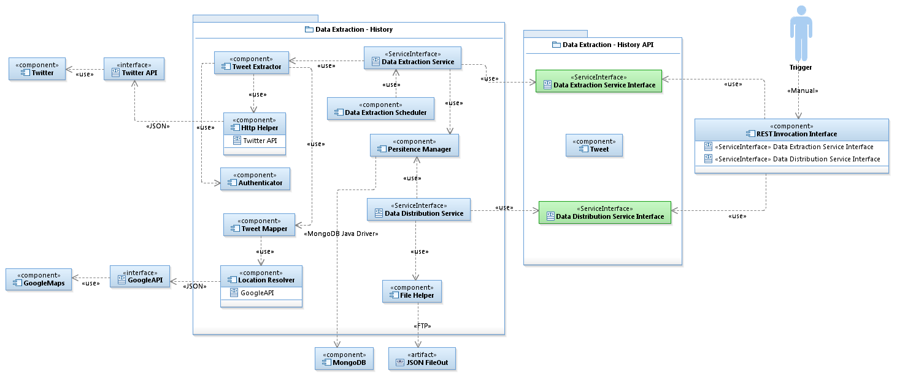
Detailed Design: History Data
Design – Façade and Singleton, DI
Approach – TDD and UDD

Slide 13
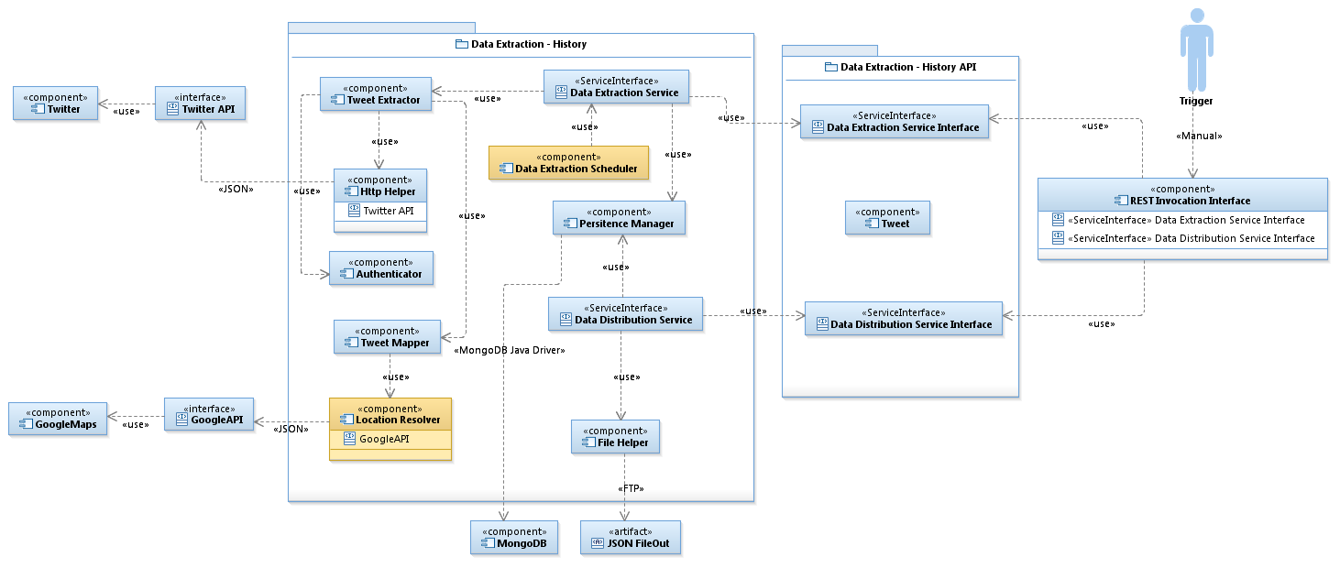
Detailed Design: History Data
Challenges – Location and Usage limits

Slide 14
Kyle Trehaeven

Slide 15
Role, Tools and Technologies
Data sourcing (Streaming/ Online Data;
Transformation application development (Apprentice Scala Developer) ☺;
Tools and Tech included:
.NET;
Tweet-Invi;
MongoDB; and
Google-Maps API

Slide 16
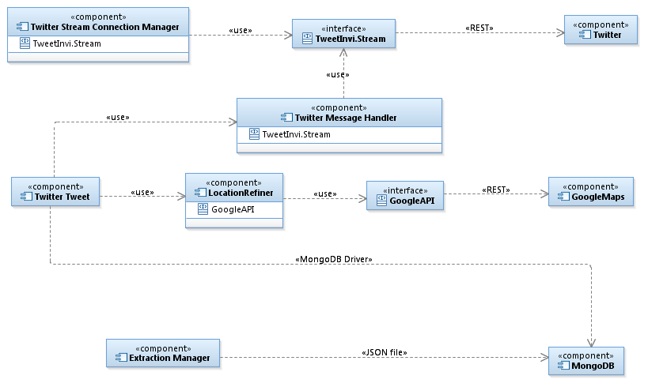
Detailed Design: Streaming Data
Approach: Component was developed as a standard-alone .NET application.
Challenges:
Sourcing the data to interrogate it to see what was available.
Verify the validity of the data (Location Data).
Consolidating output (both History and Streaming) for downstream processing.

Slide 17
Gareth Stephenson

Slide 18
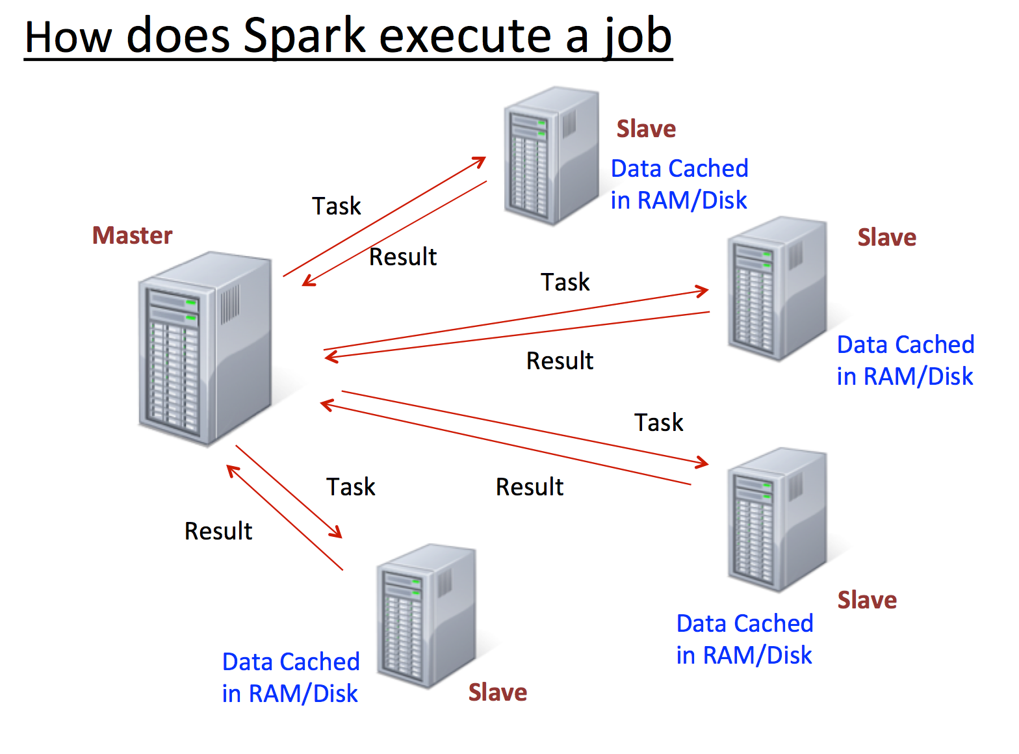
Detailed Design: Data Processing (MAP Reduce)
User shall connect to the data visualization front-end using a browser
Back-End service shall be exposed using .NET and IIS to present data to the user and to query Hadoop
Twitter data shall be persisted here and user(s) will query it/ subscribe to a topic
This component will be used to get twitter data/ streams
Twitter will be the main source of our big data for the project.
MongoDB will be used as temporary storage for the data before it is moved to Hadoop

Slide 19
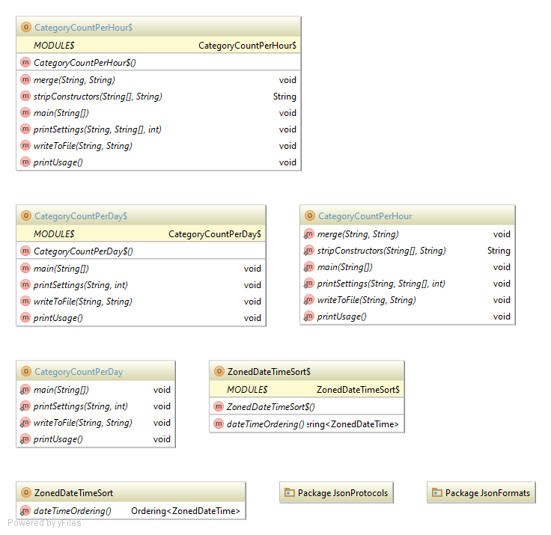
Detailed Design: Data Processing (Class Diagram)

Slide 20
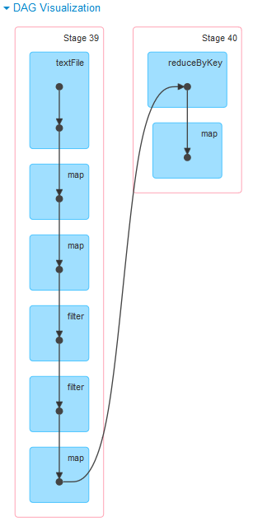
Detailed Design: Data Processing (MAP Reduce)
Approach: Component was developed as a standard-alone .NET application.
Challenges:
Sourcing the data to interrogate it to see what was available.
Verify the validity of the data (Location Data).
Consolidating output (both History and Streaming) for downstream processing.

Slide 21
Dave Cloete

Slide 22
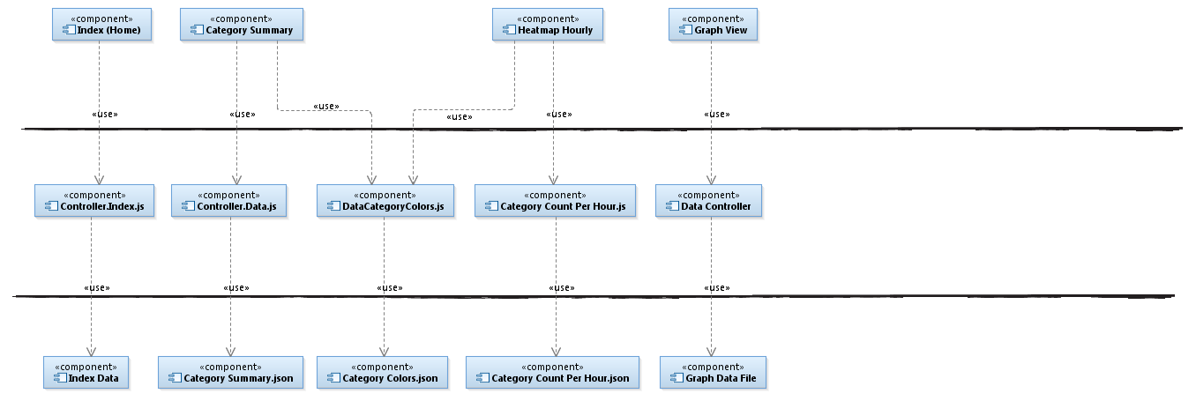
Detailed Design: Data Visualization (UX)
V
View Layer
C
Controller Layer
M
Model Layer

Slide 23
Summary of Used Technologies
Technology | Usage Description in Context of Project
Raspberry Pi | Infrastructure for processing data and for running the Front-End (D3)
J2SE | Used for the development of data acquisition from Twitter using the Twitter batch API.
C# | Used for the development of data acquisition from Twitter using the Twitter streaming/ online API.
Mongo DB
D3

Slide 24
Conclusion
All this hardware and software is available to anybody interested in Big Data processing.
The hardware is cheap and the software is free.
The learning curve in the beginning can be quite steep but is ultimately very rewarding in terms of what can be achieved with so little financial investment.

Slide 25
Referenced Material

Slide 26

Demo

Slide 27
Q & A

Slide 28
Demo: Data Visualization (UX)

Slide 29
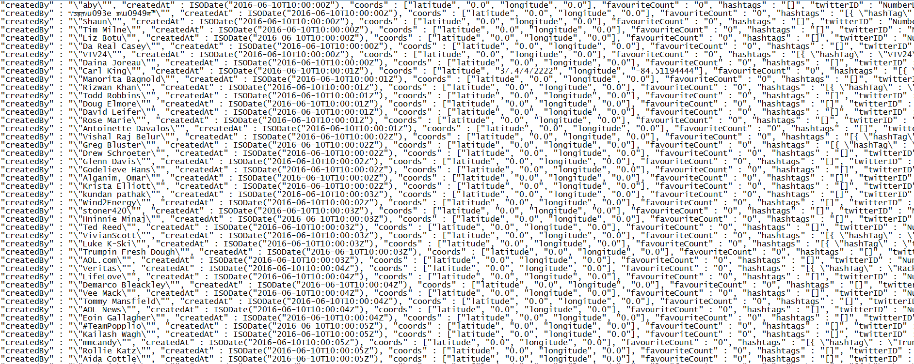
Demo: Input Data

Slide 30
Hardware: Raspberry Pi Cluster

